Slide 1
Computerized Cognitive Retraining Program for Home Training of Children with Disabilities
CSE7101- Capstone Project
Review-2
Batch Number: PSCS_19
Under the Supervision of,
Mr. Prof. John Bennet J
Assistant Professor
School of Computer Science and Engineering
Presidency University
Roll Number | Student Name
20221CAI0085 | Manoj Kumar K R
20221CAI0074 | Gnaneshwar D Y
20221CAI0063 | Vikranth Reddy Y
Name of the Program: B .Tech CSE(AIML)
Name of the HoD: Dr. Zafar Ali Khan N
Name of the Program Project Coordinator: Ms. Suma N G
Name of the School Project Coordinators: Dr. Sampath A K , Dr. Geetha A

Slide 2
Problem Statement Number: PSCS_19
Organization : Ministry of Health
Category : Software
Problem Description:
Many children with cognitive disabilities struggle with attention, memory, executive function, and problem-solving, which profoundly impacts their development, learning, and daily functioning. Traditional in-person therapy poses challenges in accessibility, scheduling, and cost. There’s an urgent need for a flexible, accessible, home-based solution to enable effective and sustained cognitive retraining.

Slide 3
Problem Statement:
Children with disabilities often experience significant challenges in cognitive domains such as attention, memory, executive function, and problem-solving, which can impede their learning and daily functioning. Traditional cognitive retraining methods typically require in-person therapy, presenting barriers related to accessibility, cost, and inflexible scheduling. These limitations leave many children unable to benefit fully from consistent cognitive rehabilitation.
Objectives:
Enhance key cognitive functions such as memory, attention, executive function, and problem-solving tailored to individual child needs.
Provide accessible, home-based therapy to overcome barriers of location, cost, and rigid schedules associated with traditional in-person interventions.
Involve caregivers actively by equipping them with tools for monitoring progress, setting goals, and modifying activities according to the child's evolving cognitive profile.

Slide 4
Background & Related Work :
Existing cognitive training systems include traditional paper-pencil tasks, therapy sessions, and mobile apps like Lumosity, CogniFit, and Elevate.
These platforms are general-purpose and not specifically designed for children with particular cognitive disabilities.
Research shows that computer-based cognitive training effectively improves attention span and working memory in children with conditions such as ADHD and Autism Spectrum Disorder.
However, there remains a significant gap in specialized, home-usable cognitive retraining systems tailored specifically for children with disabilities.
Innovation / Novel Contributions:
Customizable, gamified training modules tailored for various disabilities with offline and online support to ensure accessibility and sustained child engagement.
AI-driven adaptive difficulty and detailed progress dashboards empower personalized learning and enable caregivers and therapists to monitor and optimize therapy effectively.

Slide 5
Analysis of Problem Statement
Barriers in Current Practice:
High therapy costs limit accessibility
Shortage of trained therapists
Low motivation among children reduces engagement
Technological Opportunities:
Accessible web and mobile applications
Gamified tasks to boost motivation
Visual progress tracking for better feedback
Expected Impact:
Enhanced child independence and self-reliance
Reduced overall therapy expenses
Improved cognitive and learning outcomes

Slide 6
Analysis of Problem Statement (contd...)
Technology Stack Components:
Frontend: React.js for building an interactive, responsive user interface accessible across devices.
Backend: Python (e.g., Django or Flask) to handle server-side logic, processing cognitive training tasks, and managing user sessions securely.
Database: MySQL for structured storage of user data, progress tracking, caregiver inputs, and program configurations.
Additional Tools: Integration of AI/ML components for adaptive difficulty levels and personalized retraining exercises.
APIs & Services: RESTful APIs to connect frontend and backend, ensure smooth data exchange, and enable scalability.

Slide 7
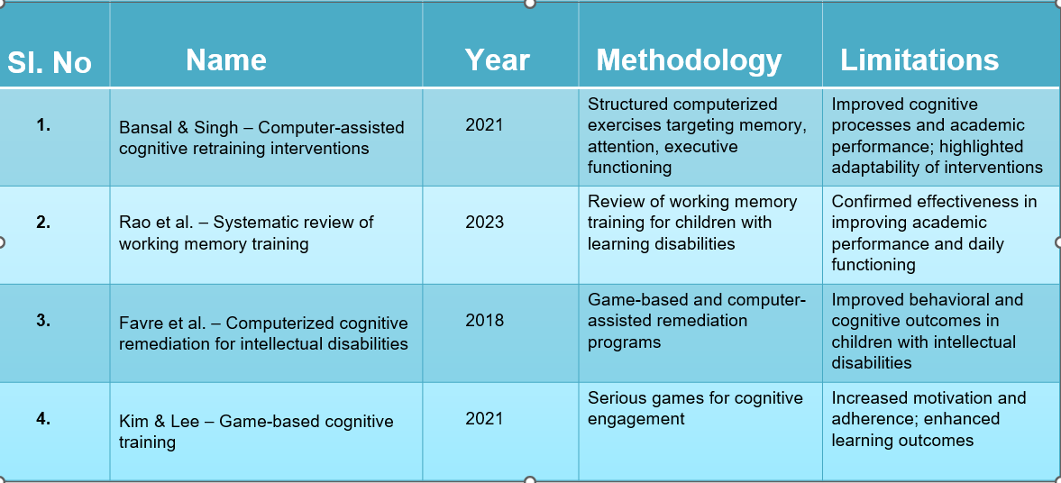
Literature Survey

Slide 8
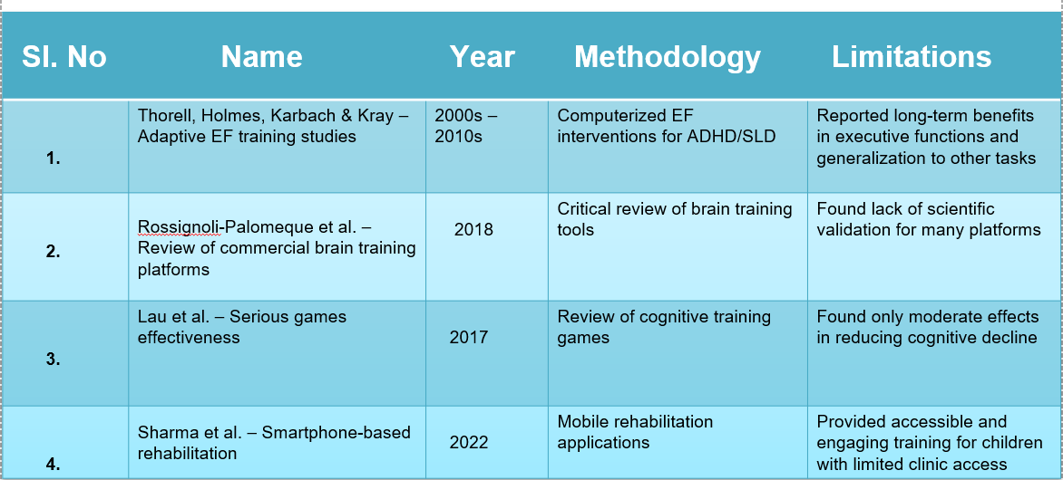
Literature Survey

Slide 9
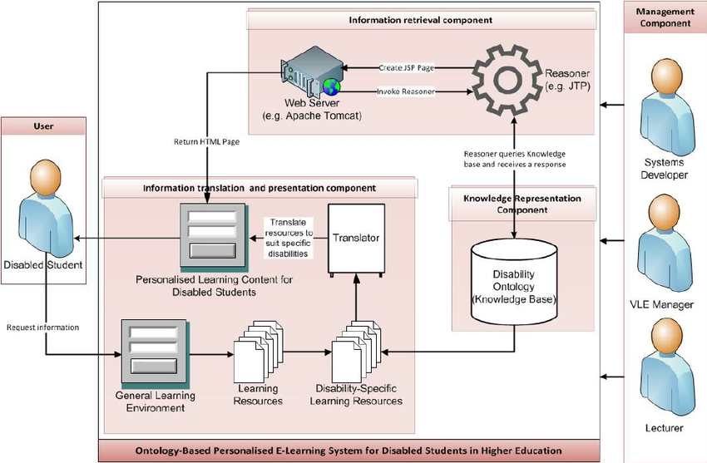
Analysis of Problem Statement (contd...)

Slide 10
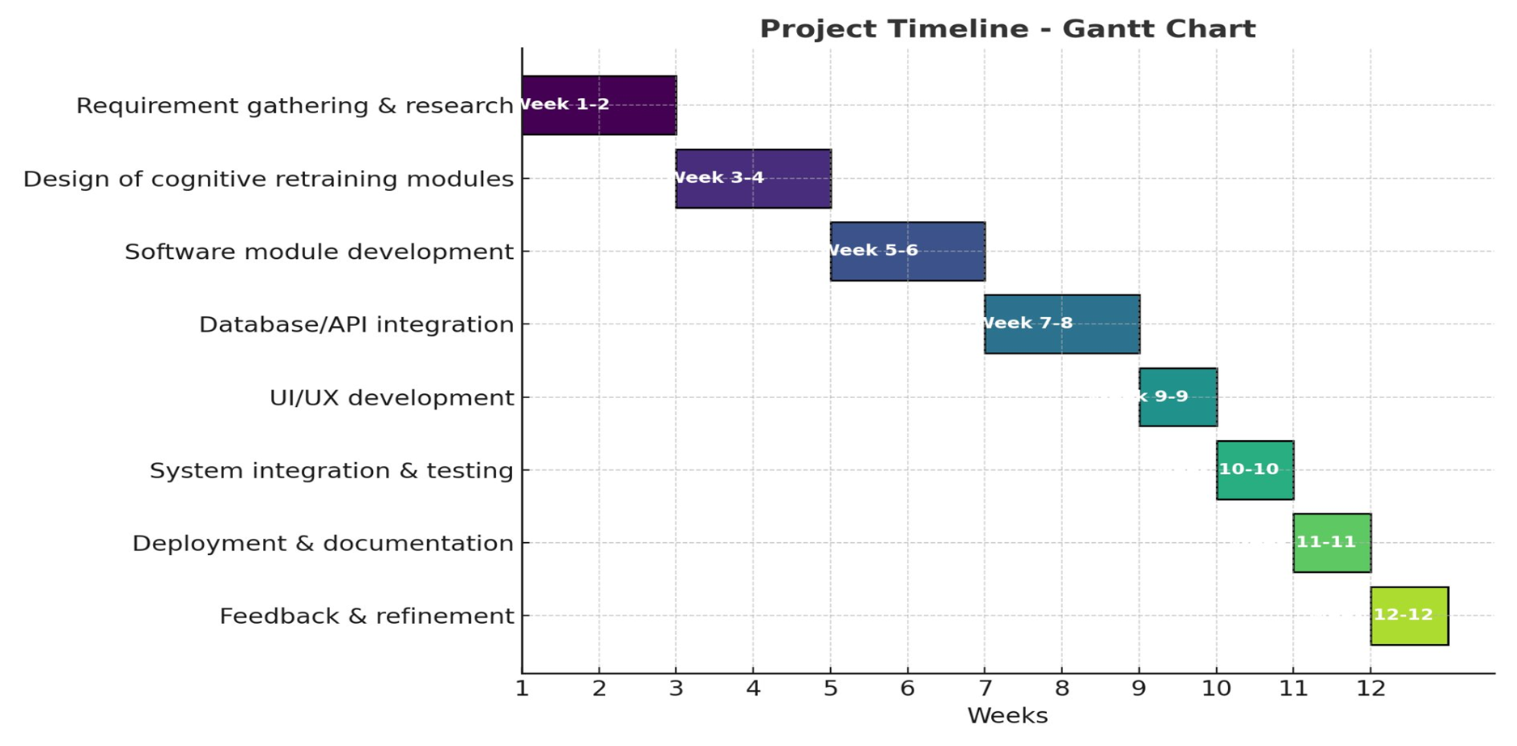
Timeline of the Project (Gantt Chart)

Slide 11
Github Link
Github Link
https://github.com/Vikranth004/capstone-project

Slide 12
References (IEEE Paper format)
Home-Based Computerized Cognitive for Disabled Children IJRASET Journal, 2025 Available: https://www.ijraset.com/best-journal/computarized-cognintive-for-disabled-children
Computerized Cognitive Retraining Program for Home Training of Children With Disabilities Scribd, 2025 Available: https://www.scribd.com/document/909742593/Computerized-Cognitive-Retraining-Program-for-Home-Training-of-Children-With-Disabilities
Effects of Home-Based Computerized Cognitive Training in Community-Dwelling Adults With MCI PubMed Central, 2023 Available: https://pmc.ncbi.nlm.nih.gov/articles/PMC10712670/

Slide 13
References (IEEE Paper format)
The Effectiveness of Computerized Cognitive Training in Poststroke Cognitive Impairment Journal of Medical Internet Research, 2025 Available: https://www.jmir.org/2025/1/e73140
Review of the Computerized Cognitive Retraining Program IJARSCT Journal, 2023 Available: https://ijarsct.co.in/Paper22655.pdf

Slide 14


